Slide 1
Donor Acquisition vs Donor Retention: Where to focus your money
KIRK SCHMIDT Director of Fundraising Optimization and Business Intelligence Alberta Cancer Foundation

Slide 2
WHY IS THIS IMPORTANT?
“If you have high retention, you should stop spending money on acquisition” – A presenter at a regional conference
We need to better understand the balance between donor acquisition and donor retention

Slide 3
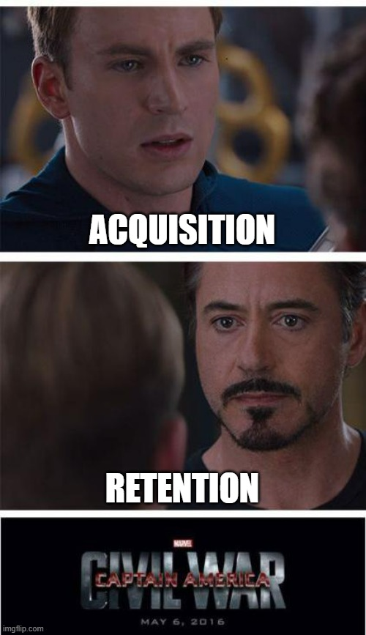
TODAY’S TALK
Why spend money on acquisition?
Why spend money on retaining?
Is one better than the other?
When should we favour one over the other?
Should we ever invest in only one?
How do we make decisions on where to invest?

Slide 4
ACQUISITION

Slide 5
DONOR ACQUISITION
Acquiring a supporter to your organization that has not previously supported the organization
Sometimes acquisition isn’t always someone new and might be channel specific – for example, we could use a list of raffle purchasers as a warm list to solicit philanthropic donations

Slide 6
WHY ACQUIRE?
Replace donors lost by attrition (acquisition-retention equilibrium)
01
Increase size of donor pool
02
Introduce new types of donors to the organization
03

Slide 7
RETENTION

Slide 8
DONOR RETENTION
Getting a donor to support the organization again
Generally is one year compared with the next. A donor who gave last year who ALSO gave this year is considered retained.

Slide 9
WHAT ABOUT LAPSED DONORS?
At what point is a recaptured lapsed donor considered acquisition or retention?
Depends on frame of view. If retention is purely this year vs last year, any lapsed donor is “re-acquisition”
Donors often “behave” like new donors if they have not given for 4-5 years+

Slide 10
RETENTION RATE
$$\frac{\text{\# }\text{of} \text{donors} \text{who} \text{gave} \text{last} \text{year} \text{AND} \text{this} \text{year}}{\text{\# }\text{of} \text{donors} \text{who} \text{gave} \text{last} \text{year}}$$
*Note: Year is the most common, but retention could be based on other periods of time

Slide 11
BREAKING APART RETENTION RATE
Overall donor retention can be affected by things other than retention: Your database’s population
New
0%
Repeat
100%

Slide 12
RETENTION BY GROUP
New donors
First gift was last year
Existing donors (repeat and recovered)
Repeat: Gave last year and the year before
Recovered: Gave last year and were lapsed the year before (but gave previously)

Slide 13
OTHER WAYS TO BREAK APART RETENTION
By Channel (Direct Mail, Email, Ads, etc)
By Demographics / Psychographics
By actions (Received a Thank You call)

Slide 14
G and L Coding
Gave (G1)
Gave (G2)
Gave (G3)
Lapsed (L1G2)
Lapsed (L1G1)
Gave (G1L1G1)
Year 1
Year 2
Year 3
Lapsed (L2G1)

Slide 15
2ND GIFT COVERSION VS NEW RETENTION
2nd gift conversion is the propensity to get a second gift regardless of explicit time periods (although you can measure likelihood within certain time periods)
Retention is about time periods related to each other (usually years) – who gave this year that also gave last year
BOTH are important

Slide 16
WHICH IS BETTER: ACQUISITION OR RETENTION

Slide 17
IS THERE EVER A TIME TO ONLY ACQUIRE?
We don’t have any donors to the organization
Our retention rate cannot be improved

Slide 18
IS THERE A TIME TO ONLY RETAIN?
There are no new donors to acquire
Acquisition operates at a loss long term

Slide 19
4-10x more expensive to acquire than to retain

Slide 20
“An increase in 10% in retention will double lifetime value of the database”

Slide 21
… but, as long as your retention rate is less than 100%, you will slowly lose donors unless you acquire

Slide 22
… And as long as acquisition is profitable in the long term, more acquisition means more money
(but that usually requires good retention!)

Slide 23
ACQUISITION OR RETENTION?
YOU WILL HAVE TO DO BOTH!

Slide 24
When might you prioritize acquisition?
Retention is already very high
You are losing donors faster than you are gaining
When might you prioritize retention?
Retention rates are low (too many donors leaving)
Donation amounts are low (acquisition operates at a loss, even with decent retention)

Slide 25
METRICS FOR
ACQUISITION AND RETENTION

Slide 26
WHAT DO WE WANT TO KNOW?
Is acquisition net positive?
Are we maintaining our donor pool?
How many donors do we need to acquire to have a donor pool of X?
Can we objectively determine whether to invest in acquisition or retention?

Slide 27
METRICS WE WILL TALK ABOUT
Acquisition Rates
Cost of Acquisition
Retention Rate(s)
Cost of Retaining
Lifetime
Lifetime Value
Donor Acquisition Equilibrium

Slide 28
ACQUISITION RATE
$$\frac{\text{\# }\text{of} \text{donors} \text{acquired}}{\text{\# }\text{of} \text{people} \text{solicited}}$$
Why is this important?
Compare different methods of acquisition to see which ones will bring in more donors

Slide 29
DONOR ACQUISITION COST
$$\frac{\text{Cost} \text{of} \text{Acquisition}}{\text{\# }\text{of} \text{donors} \text{acquired}}$$
Why is this important?
Helping determine whether acquisition cost will be covered by revenue
For comparing different acquisition methods

Slide 30
RETENTION RATE(S)
Overall $\frac{\text{\# }\text{of} \text{donors} \text{who} \text{gave} \text{last} \text{year} \text{AND} \text{this} \text{year}}{\text{\# }\text{of} \text{donors} \text{who} \text{gave} \text{last} \text{year}}$
New $\frac{\text{\# }\text{of} \text{donors} \text{who} \text{first} \text{gave} \text{last} \text{year} \text{AND} \text{gave} \text{this} \text{year}}{\text{\# }\text{of} \text{donors} \text{who} \text{first} \text{gave} \text{last} \text{year}}$
Existing $\frac{\text{\# }\text{of} \text{donors} \text{who} \text{gave} \text{last} \text{yr}\text{ (}\text{not} \text{new}\text{)} \text{AND} \text{gave} \text{this} \text{yr}}{\text{\# }\text{of} \text{donors} \text{who} \text{gave} \text{last} \text{year}\text{ (}\text{not} \text{new}\text{)}}$

Slide 31
COST OF RETAINING A DONOR (ANNUAL)
$$\frac{\text{Total} \text{Spent} \text{on} \text{Cultivation} \text{and} \text{Solicitation}}{\text{\# }\text{Active} \text{Donors}}$$
*There are other ways to calculate this
Why is this important?
Keeping donors isn’t free. We need to factor in long term costs

Slide 32
LIFETIME
Option 1: Based on overall retention
$$\frac{1}{1−\text{retention} \text{rate}}$$
Option 2: Based on new and existing retention rates
$$1+\frac{\text{new} \text{donor} \text{ret}\text{.}}{1 −\text{existing} \text{donor} \text{ret}\text{.}}$$

Slide 33
LIFETIME
Option 1: Based on overall retention (50%)
$$\frac{1}{1−\text{0.50}}=2$$
*Answer could be between 1.25 and 2.5 depending on proportion of new/existing
Option 2: Based on new (20%) and existing (60%) retention rates
$$1+\frac{\text{0.2}}{1 −\text{0.6}}=1.5$$

Slide 34
ESTIMATED LIFETIME VALUE
Estimated lifetime value in general is a calculation of the expected number of donors each year multiplied by how much they are expected to give.
$$\text{Lifetime}\text{ × }\text{Average} \text{Annualized} \text{Gift}$$
There are other more complicated ways to do this with modeling that will be more accurate, but require more math!

Slide 35
WHEN IS ACQUISITION NET POSITIVE?
When Estimated Lifetime Revenue
$$\text{Lifetime} \text{×} \text{Average} \text{Annualized} \text{Gift}$$
Is larger than Estimated Lifetime Costs
$$\text{Donor} \text{Acquisition} \text{Cost}\text{ + }\left(\text{Cost} \text{of} \text{Retaining} \text{a} \text{Donor}\text{ × }\text{Lifetime}\right)$$

Slide 36
DONOR ACQUISITION EQUILIBRIUM
What we will need:
New Donor Retention Rate
Existing Donor Retention Rate
Target Number of Donors

Slide 37
DONOR ACQUISTION EQUILIBRIUM

Slide 38
EXAMPLE
Target is 1,000 donors
New Donor Retention Rate is 20% (0.2)
Existing Donor Retention Rate is 40% (0.4)
$$1000×\left(1−\frac{0.2}{0.2−0.4+1}\right)⇒1000×\left(1−\frac{0.2}{0.8}\right)⇒1000×\left(0.75\right)⇒750$$

Slide 39
EXAMPLE (CONTINUED)
750 donors need to be acquired every year
We have 1,000 donors (250 existing, 750 new)
250 x 40% = 100
750 x 20% = 150
100 + 150 = 250 donors who will give again. We need 750 more.

Slide 40
WHAT IF NEW DONOR RETENTION INCREASES
$1000×\left(1−\frac{0.25}{0.25−0.4+1}\right)⇒1000×\left(1−\frac{0.25}{0.85}\right)≅705$
We need to acquire 45 less donors per year (705 instead of 750).
What costs more? Increasing new donor acquisition by 5% or acquiring 45 new donors?

Slide 41
EXAMPLE #2
If you could increase existing retention by 8% or increase new donor retention by 3% for the same investment, which should I invest in? $$1000×\left(1−\frac{0.23}{0.23−0.4+1}\right)⇒1000×\left(1−\frac{0.23}{0.83}\right)⇒723$$
$$1000×\left(1−\frac{0.2}{0.2−0.48+1}\right)⇒1000×\left(1−\frac{0.2}{0.72}\right)⇒722$$

Slide 42
EXAMPLE #3
What if you started with 10% new donor (to increase by 3%), and 70% existing (to increase by 8%). This also starts with 750 donors to acquire $$1000×\left(1−\frac{0.13}{0.13−0.7+1}\right)⇒1000×\left(1−\frac{0.13}{0.43}\right)⇒698$$
$$1000×\left(1−\frac{0.1}{0.1−0.78+1}\right)⇒1000×\left(1−\frac{0.1}{0.32}\right)⇒687$$

Slide 43
PUTTING A PRICE ON RETENTION
It will be inexact, unless you have a test
Ex. We called half of the donors on the next day to thank them, and their retention went up by X%
At that point you can price the internal cost of doing it from now on

Slide 44
USING EQULIBRIUM TO DECIDE
Using the Donor Acquisition Equilibrium we can decide, if we want a specific number of donors:
Is it cheaper to acquire more?
Is it cheaper to make existing donor retention better?
Is it cheaper to make new donor retention better?

Slide 45
TODAY’S TALK
Why spend money on acquisition?
Why spend money on retaining?
Is one better than the other?
When should we favour one over the other?
Should we ever invest in only one?
How do we make decisions on where to invest?

Slide 46
EVEN WITH METRICS, IT’S INEXACT
You will never control every variable, but using metrics you can help your decision-making
Understanding when one might be more favorable is half the battle
Metrics will help, especially to see if acquisition is profitable, or what could happen if you were able to alter the number of donors acquired or the retention rates

Slide 47
FINAL CONSIDERATIONS
Long-term donors are more likely to be major or legacy donors (retention)
The higher your retention rate, the harder it is to increase further (diminishing returns)
Even if acquisition is cheap, with low retention you may end up churning through potential donors
The higher the retention, the more profitable acquisition will be!

Slide 48
QUESTIONS?
Kirk Schmidt
Director of Fundraising Optimization and Business Intelligence

